Slide 1

Human Activity Recognition using smartphone dataset
Project By: NEHA PANCHAL
INFo 6105 DATA SCIENCE ENGINEERING METHODS | PROF RAM HARIHARAN

Slide 2
Introduction
This project aims to build a model that predicts the human activities such as Walking, Walking Upstairs, Walking Downstairs, Sitting, Standing and Laying from the Sensor data of smart phones.
The data is recorded with the help of sensors

Slide 3
Dataset
All the data is present in 'UCI_HAR_dataset/' folder in present working directory.
Train Data
'UCI_HAR_dataset/train/X_train.txt'
'UCI_HAR_dataset/train/subject_train.txt'
'UCI_HAR_dataset/train/y_train.txt'
Test Data
'UCI_HAR_dataset/test/X_test.txt'
'UCI_HAR_dataset/test/subject_test.txt'
'UCI_HAR_dataset/test/y_test.txt'

Slide 4
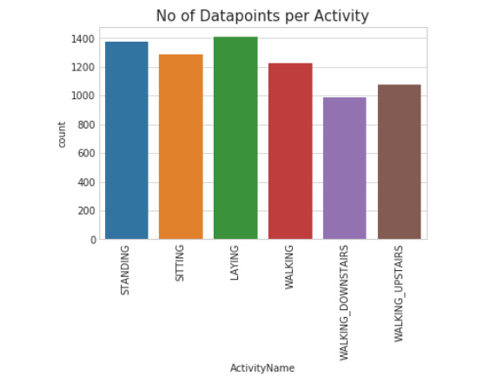
Data Analysis
Data cleaning has been done for null values and duplicate values
Imbalance check for number of data points per activity is plotted here

Slide 5
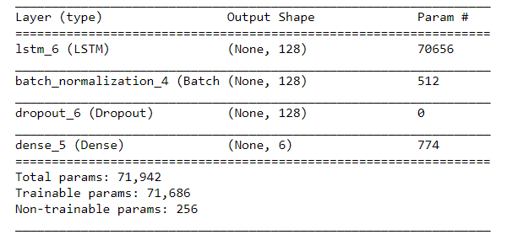
Model 1 Structure
With a simple semi tuned LSTM structure I got 91.48% accuracy and a loss of 0.29

Slide 6
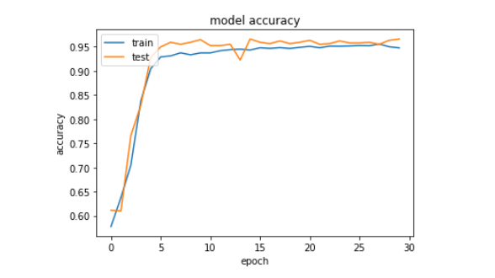
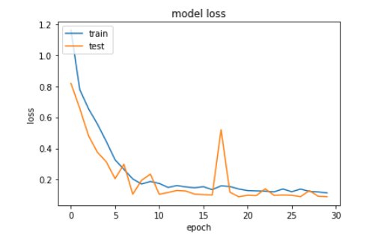
Model 1 accuracy and loss

Slide 7
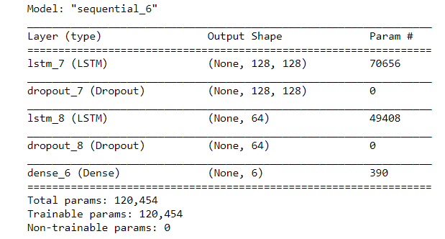
Model 2 Structure
With Tuned model, I got 92% accuracy

Slide 8
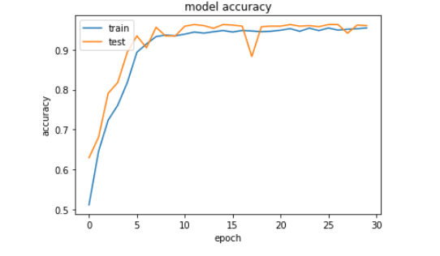
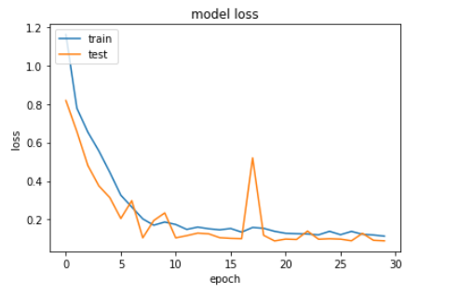
Model 2 accuracy and loss

Slide 9

Thank You
NAME: Neha Panchal
NUID: 001491279
COURSE:
INFo 6105
DATA SCIENCE ENGINEERING METHODS
PROF RAM HARIHARAN

